Slide 1

CSI 5388 Assignment 1
Understanding tokenization and word embedding
Group Details:
Aaditya Suri
Ranjan Goyal
Paritosh Pal Singh

Slide 2
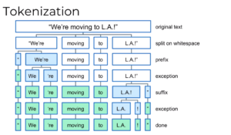
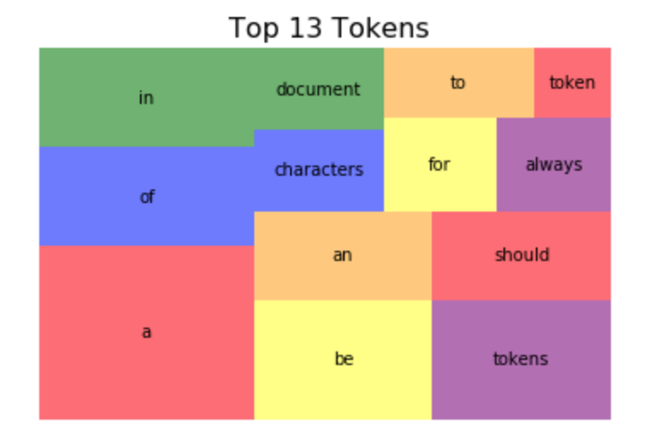
Problem Statement and Introduction
Implement a word tokenizer that splits texts into tokens and separates punctuation marks and other symbols from the words.
What is Tokenization ?
Tokenization is the process of breaking up the original raw text into component pieces which are known as tokens.
Tokenization is usually the initial step for further NLP operations like stemming, lemmatization, text mining, text classification, sentiment analysis, language translation, chatbot creation, etc.
What are Tokens ?
Tokens are broken pieces of the original text that are produced after tokenization. Tokens are the basic building blocks of text -everything that helps us understand the meaning of the text is derived from tokens and the relationship to one another. For example, the character is a token in a word, a word is a token in a sentence, and a sentence is a token in a paragraph.

Slide 3
Assignment 1 a, Corpus Output
Corpus output for first 10 posts
['``', 'Yeah', ',', 'I', 'get', 'that', 'argument', '.', 'At', 'this', 'point', ',', 'I', "'d", 'prefer', 'is', 'she', 'lived', 'in', 'NC', 'as', 'well', '.', "''"],
['The', 'blazers', 'and', 'Mavericks', '(', 'The', 'wests', '5', 'and', '6', 'seed', ')', 'did', 'not', 'even', 'carry', 'a', 'good', 'enough', 'record', 'to', 'make', 'the', 'playoffs', 'in', 'the', 'east', 'last', 'year', '.’],
['They', "'re", 'favored', 'to', 'win', '.’],
['deadass', 'do', "n't", 'kill', 'my', 'buzz’],
['Yep', 'can', 'confirm', 'I', 'saw', 'the', 'tool', 'they', 'use', 'for', 'that', '.', 'It', 'was', 'made', 'by', 'our', 'boy', 'EASports_MUT’],
['do', 'you', 'find', 'ariana', 'grande', 'sexy', '?’],
['What', "'s", 'your', 'weird', 'or', 'unsettling', 'Trick', 'or', 'Treat', 'story', '?’],
['Probably', 'Sephiroth', '.', 'I', 'refuse', 'to', 'taint', 'his', 'greatness', 'with', '*', 'my', '*', 'weak', 'builds', '.', 'He', 'should', 'equip', '*', 'ONLY', '*', 'the', 'best', 'TMs', '.’],
['``', 'What', 'to', 'upgrade', '?', 'I', 'have', '$', '500', 'to', 'spend', '(', 'mainly', 'because', 'it', "'s", 'my', 'birthday', 'on', 'the', '31st', ')', 'and', 'I', "'m", 'not', 'really', 'sure', 'what', 'to', 'upgrade', '.', 'I', 'do', "n't", 'have', 'to', 'spend', 'all', '$', '500', ',', 'I', 'could', 'spend', 'as', 'little', 'or', 'all', 'of', 'it', 'if', 'I', 'want', '.', 'Specs', 'are', ':', 'CPU', ':', 'i5-6600K', 'Cooler', ':', 'CM', '212', 'EVO', 'RAM', ':', '8GB', 'Corsair', 'Vengence', 'LPX', '2400MHz', 'GPU', ':', 'EVGA', 'GTX', '1070', 'SC', 'Case', ':', 'Corsair', 'Spec', 'Alpha', 'PSU', ':', 'EVGA', 'P2', '650w', 'Storage', ':', 'One', '480', 'GB', 'Corsair', 'Force', 'LE', 'Monitor', ':', 'BenQ', 'XL2411Z', 'Keyboard', ':', 'Razer', 'Blackwidow', 'Tournament', 'Edition', 'What', 'I', "'m", 'thinking', 'of', 'right', 'now', 'is', ':', '-Get', 'a', '1TB', 'WD', 'Blue', '-Buy', 'another', '8GB', 'of', 'RAM', '-Replace', 'my', 'Razer', 'Blackwidow', 'with', 'a', 'keyboard', 'with', 'actual', 'Cherry', 'MX', 'switches', '-Replace', 'my', 'case', '(', 'Does', "n't", 'really', 'offer', 'features', 'for', 'good', 'cable', 'management', ')', '-Save', 'up', 'for', 'a', 'Volta', 'Card', "‘’”],
['``', 'Probably', 'count', 'Kanye', 'out', 'Since', 'the', 'rest', 'of', 'his', 'tour', 'is', 'canceled', ',', 'it', 'does', "n't", 'seem', 'in', 'the', 'cards', '.', 'But', 'he', "'s", 'also', 'so', 'unpredictable', ',', 'it', 'could', 'change', '.', 'Thankfully', 'I', 'saw', 'him', 'before', 'he', 'started', 'canceling', 'shows', ',', 'going', 'on', 'long', 'rants', 'and', 'showing', 'up', 'late', '.', 'But', 'I', "'d", 'love', 'to', 'see', 'him', 'again', ',', 'especially', 'at', 'Lolla', '.', 'Thoughts', '?', "''"]

Slide 4
Assignment 1 – Part A
Number of Tokens
Type/Token Ratio
2,915,666
0.036423
Number of types ( unique tokens) divided by total number of tokens in the corpus
Total number of Tokens obtained from corpus without removing punctuations or stop words
Number of Types
Token Appeared Only Once
106,200
57,847
Total number of unique Tokens obtained from corpus without removing punctuations or stop words
Tokens which are occurring only one in the corpus

Slide 5
Number of words
Top 3 most frequent words
Type/Token Ratio

Slide 6
Type/Token Ratio
Top 3 most frequent words
Top 3 most frequent Bigrams

